Slide 1
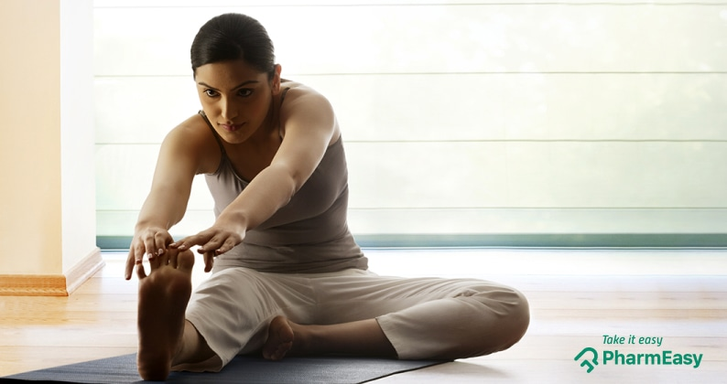

Slide 2
- MAKE
YOURSELF
BETTER

Slide 3
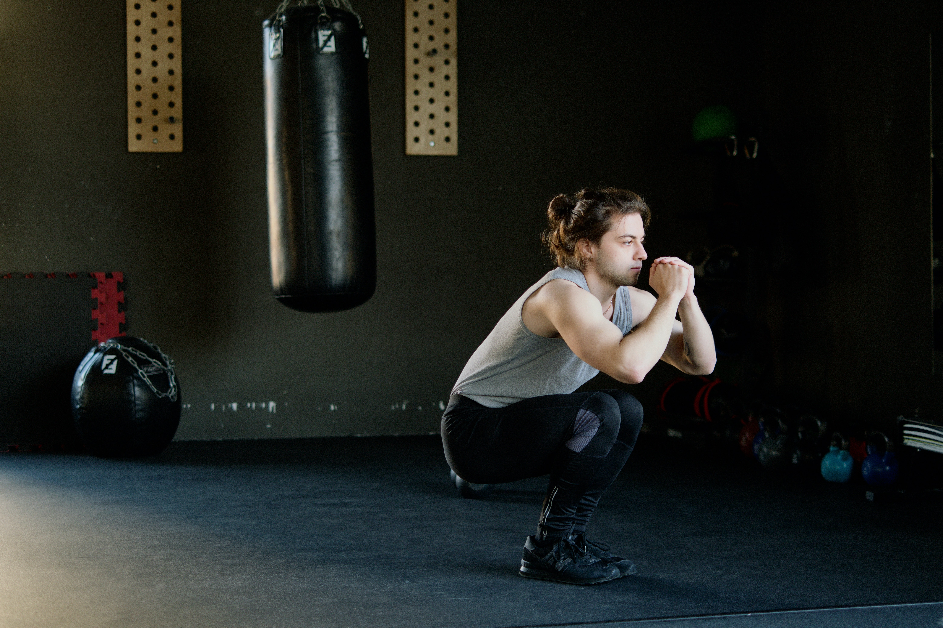


Slide 4
Squat Kick
Push up
Plank
Lunge

